Slide 1
Different Types of CSS
Computer Science

Slide 2
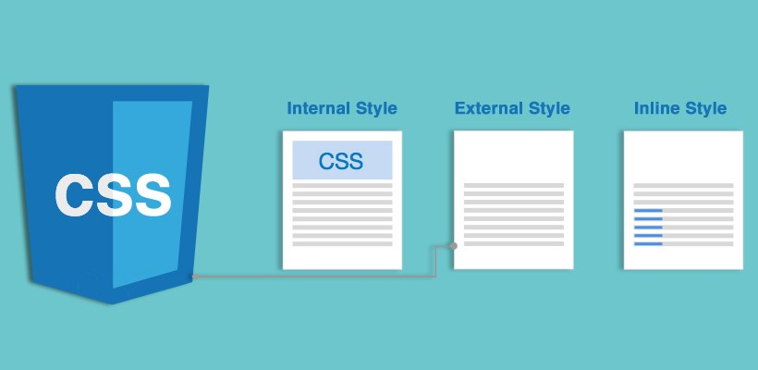
Learning Intention:
In this PowerPoint you will learn:
External CSS
Internal CSS
Inline CSS
When to use then
CSS hierarchy/priority

Slide 3
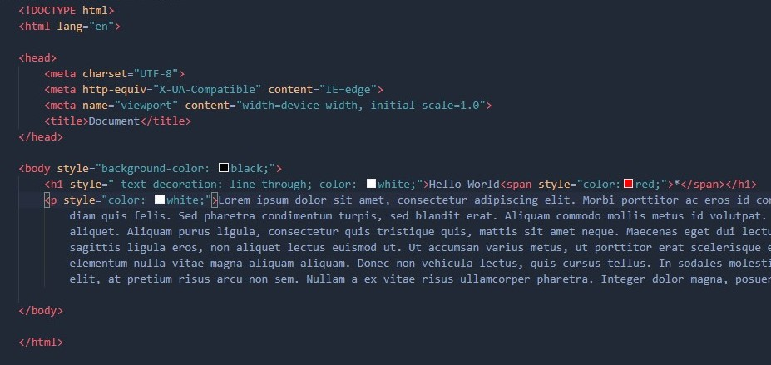
Inline CSS

Slide 4
Inline CSS
Inline CSS is useful when u want to style a specific element well come onto why another slide.
To use inline CSS we go to the opening tag.
Then we add “style=“””
Then we can add whatever CSS we want inside of the quotation marks
<p></p>
<p style=“” ></p>

Slide 5

Real life examples on when to use Inline CSS
For example we would use inline CSS for making this asterisk red

Slide 6
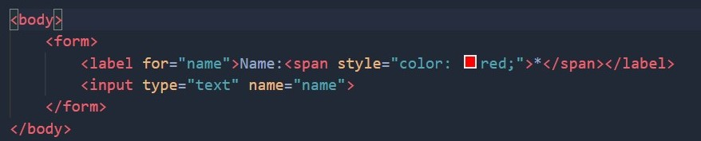
The code for this would look like
Where is inline CSS used in this example.
What character does this style

Slide 7
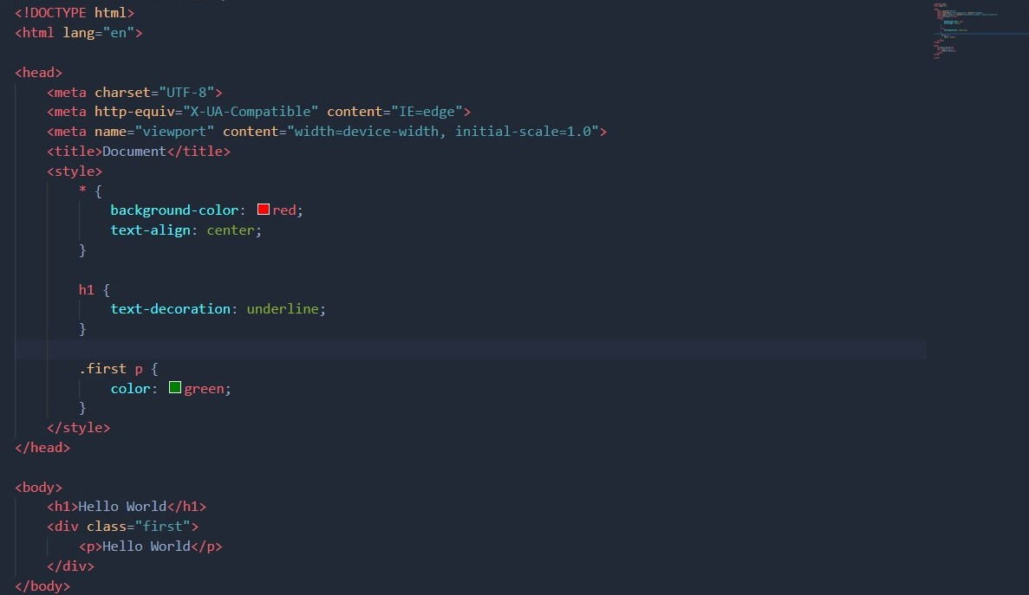
Internal CSS

Slide 8
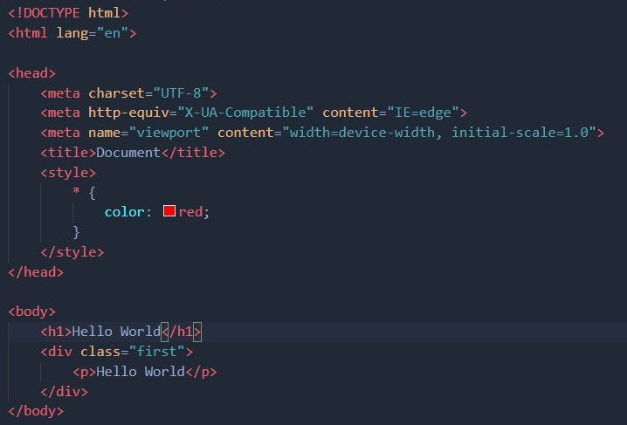

Internal CSS
We would use internal CSS when we want a page to have a unique style to it
To use internal CSS we use the style tag in between the head tags
For example say we want to style all text in this page to be red we would have code that looks like this
This is the output

Slide 9
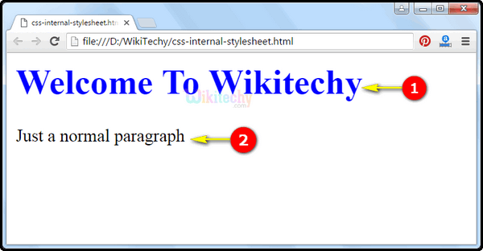
Internal CSS Quiz
Why do we use internal CSS
What is the tag we use for internal CSS
Where do we put that tag
How would we make 1 blue using internal CSS
<style></style>

Slide 10
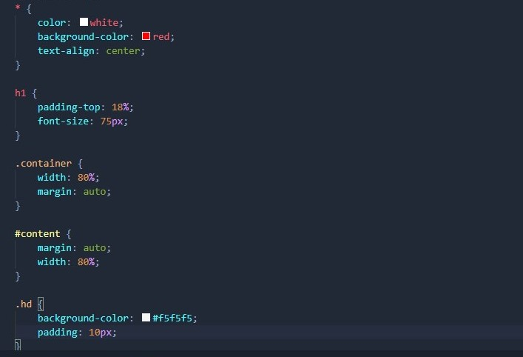
External CSS

Slide 11
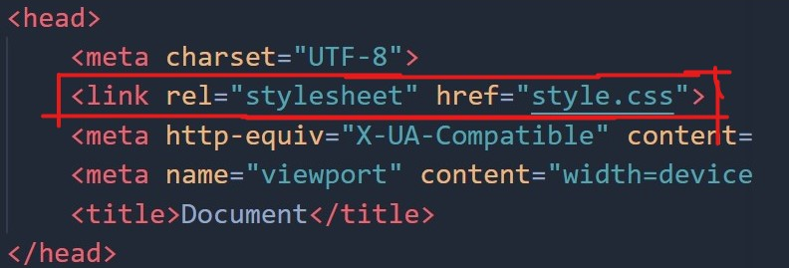
External CSS
We use external CSS when we want to style/effect multiple pages.
It is more efficient that using internal or inline CSS for repeating elements
To use external CSS we use the link tag with the info of its relationship with the html file using rel=“stylesheet” and its location href=“style.css”

Slide 12
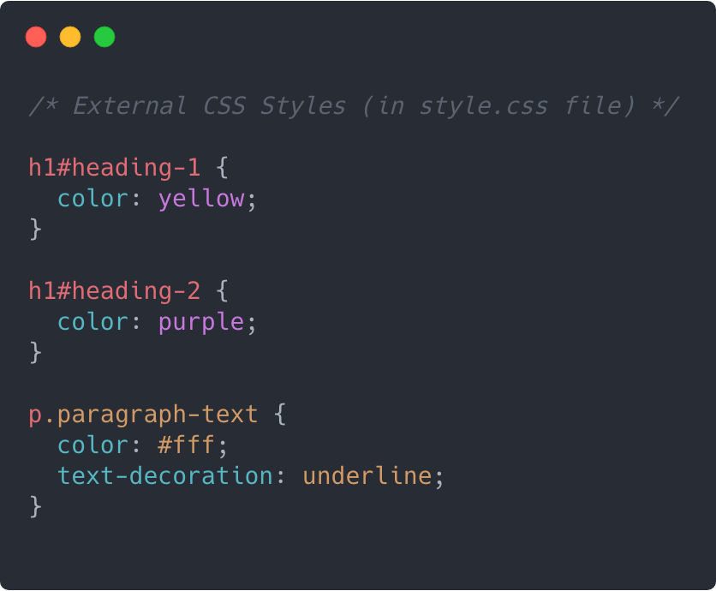
External CSS Quiz
What is the tag we use to link to the external CSS
Do we need to add the file extension for CSS
Do we need to link from CSS to html

Slide 13
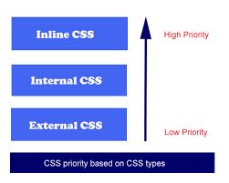
CSS Hierarchy/Priority
In html/CSS we have something calls CSS hierarchy which allows certain things to be overridden
Say our external CSS says all text should be red but we want the word plug to be green we would use inline CSS to override that Or the !important tag(well talk about that next slide)

Slide 14
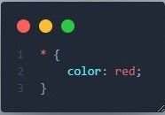

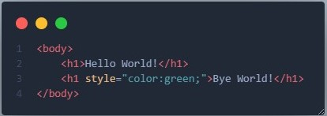
Priority Quiz
What colour will
Hello World
Bye World!
If this is our CSS file is this
And our html file looks like this

Slide 15
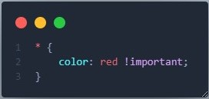
!important
Another way to override a CSS rule is by using the “!important” at the end of a CSS line

Slide 16

Task
Make a basic website using at least 2 of the CSS methods
Internal
External
Inline

